Slide 1
























Building Communities
GNOME.Asia Summit
20th November 2009
Pockey Lam, Beijing Linux User Group
pockey@beijinglug.org
www.beijinglug.org

Slide 2
Agenda
Define “community”
Founding a community
Growing a community
  Online presence with BLUG case study
  Offline presence with BLUG case study
More tips
What it takes to be a community leader

Slide 3
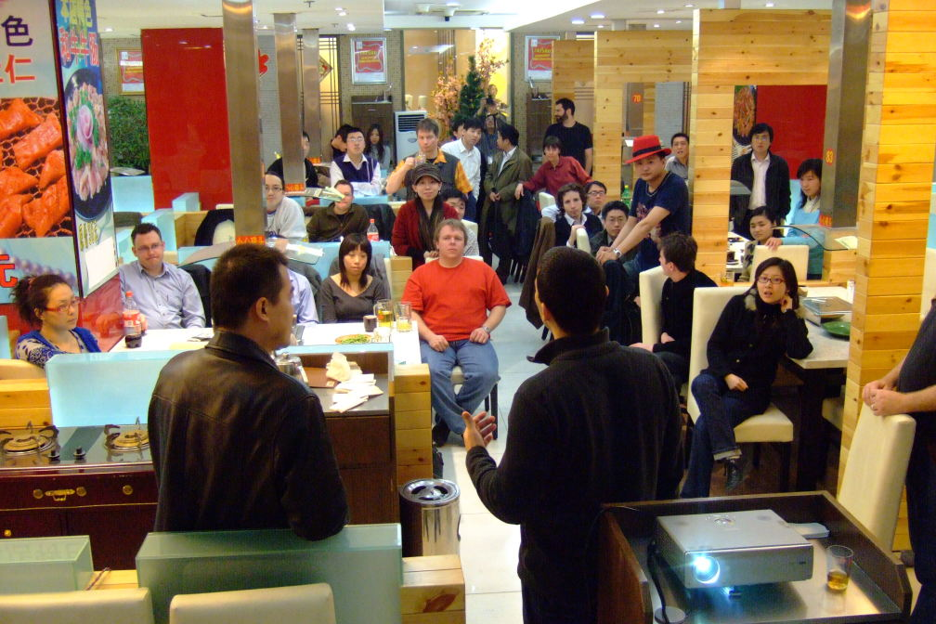
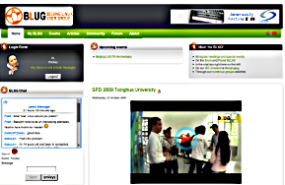
Define “community”
Free and Open Source Software (FOSS) community
Local community, not just online community
+

Slide 4
Founding a community
Communicate with other FOSS related communities nearby
Spread the word of your intention
Find a location
Schedule a time
Communicate with your target audiences
  Free newspapers / magazines
  Blogging
  New media e.g. facebook, twitter, linkedin

Slide 5
Founding a community
Host a initial meeting to discuss:
  The goals
  Building an online platform (for people to find you from the Internet)
  Establishing a mailing list for communication
  Hosting regular meetings (decide the best date / time / location for the group)
  Getting a few volunteers to help out
  Next topics (what people are interesting about)

Slide 6
Growing a community
Membership: Open to public and Free to join
Online presence: Website
  Announce activities clearly and early with maps / date / time / agenda (REGULARLY)
  Archive your activities
  Communication: Mailing list VS Forum
  Pick the right URL and host your website
  Pick an infrastructure that is easy:
    For multi-users to contribute
    To add features and components

Slide 7
BLUG Case Study: Website

Slide 8
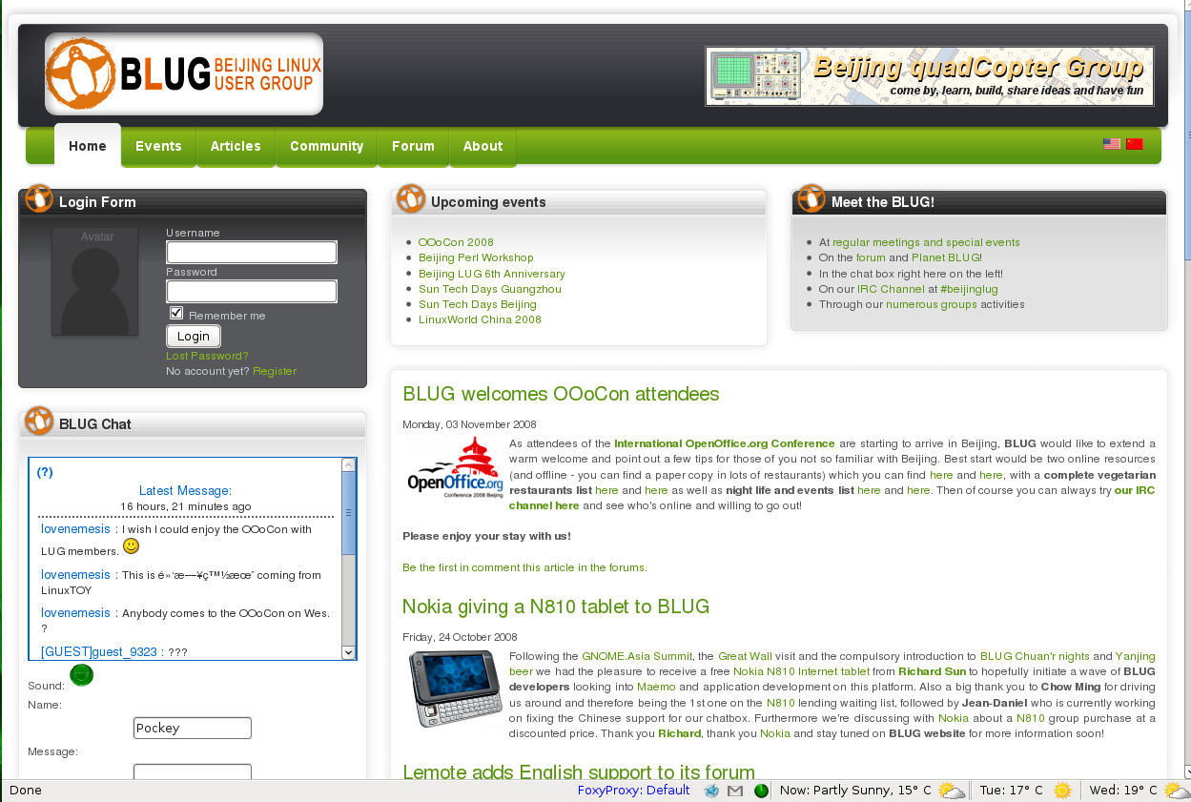
News / Meetings announcement
Meetings reminder by SMS VS Emails

Slide 9
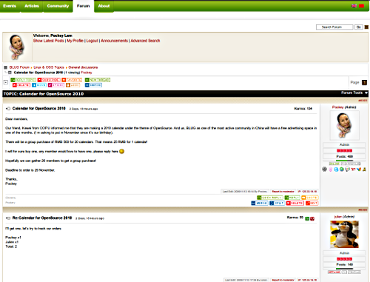
BLUG Forum
Different categories

Slide 10
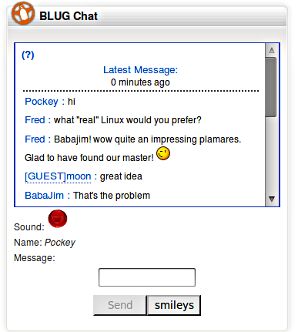
BLUG Chatbox
Open for non-members / members

Slide 11
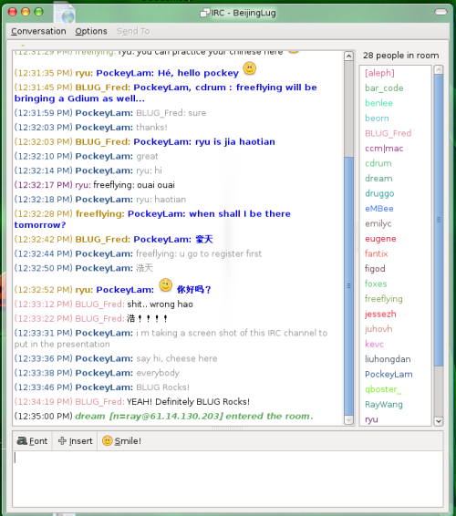
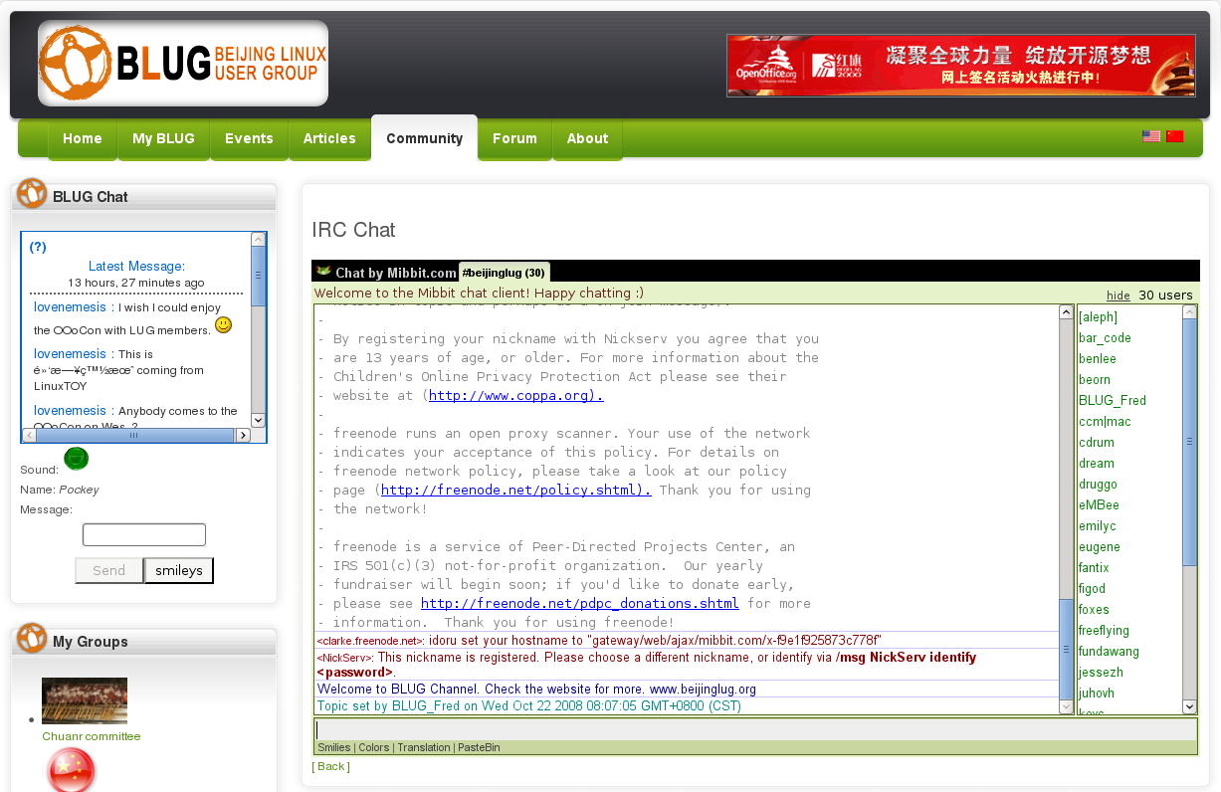
BLUG IRC Channel
Provide supports to members @Freenode #chinalug / #beijinglug

Slide 12
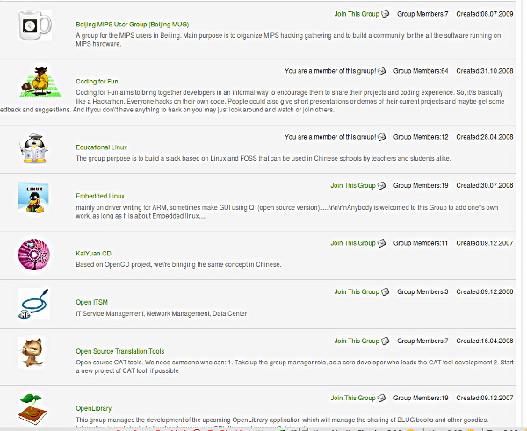
BLUG Groups

Slide 13
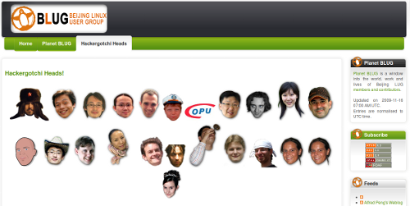
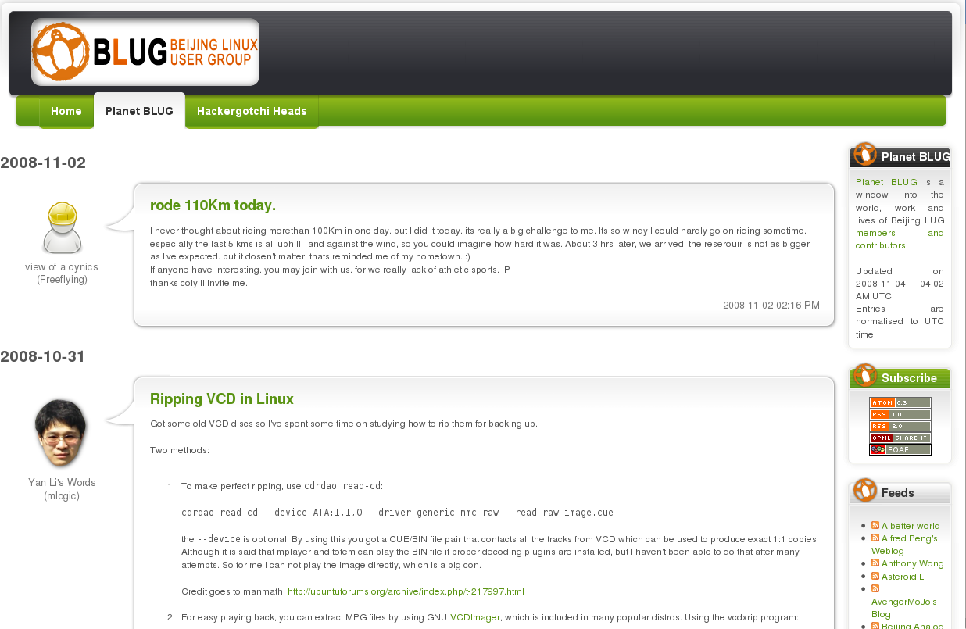
BLUG Planet
Planet BLUG is a window into the world, work and lives of Beijing LUG members and contributors

Slide 14
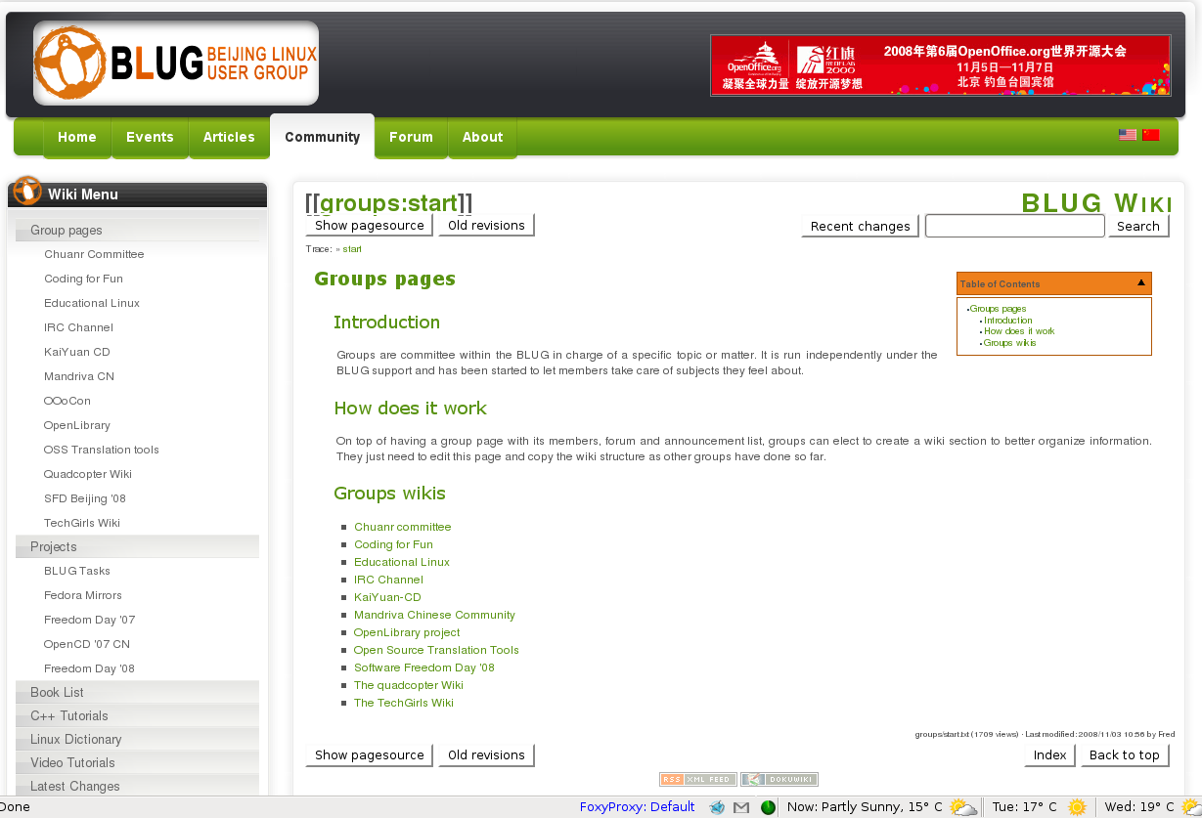
BLUG WIKI

Slide 15
Growing a community
Offline presence: Regular meetings
  Time: available and convenient
  Location: available and accessible
  Key points:
    Regular
    Consistent, host as promised and advertised
    Maintain good relationship with vendors
    Affordable and diversity
    Avoid weekends or peak time/ hour
    Booking in advance and arriving earlier

Slide 16
Growing a community
Topics:
  Technical presentations
  Interesting projects / topics
  Informal discussion groups
  Installfest
  Configuration, coding and bug-fixing
  Social
How?
  By members themselves
  By talking to companies and other communities
  By joining conferences and inviting speakers

Slide 17
BLUG Case Study: Activities

Slide 18
BLUG offline activities
Meeting: Regular meetings and Guest in town
Social: Chuanr (skewers) night and Anniversary
Conferences: SFD, installfest and other events
Interest group meetings
  Coding for Fun
  Quadcopter
  Educational Linux
  RepRap
  Techwomen
  Much more

Slide 19
More tips
Elect a representative for your community
Find out what your members want to do
Create open communication between members
Avoid self-promotion and company promotion
Not to involve “money” if possible
Get a group identity
  Jon Phillips, Founder of Open Clip Art Library: “Remember, the BLUG is totally not a LUG, its one of the best sets of people I’ve met working in this area in any city with great ideas and focus, and not just coming to get their printer working.”

Slide 20
More tips
Get approached by press
Have social events regularly
Host FOSS events once / twice a year
Get your members involved
Reward your members
Have name cards for yourself / your core members
Maintain / update the website

Slide 21
Be a community leader
Don't be afraid to be the leader
Have people skill
Time and Patience
Introspection, commitment and honesty
Greet / Listen to your members
Put community first
Share decision making process
Able to take criticism
Achievement and Satisfaction

Slide 22
Community Rocks!
Any question?
pockey@beijinglug.org
www.beijinglug.org

